Slide 1

Plant Pals
Customer Survey Results
To gauge customer satisfaction with the product and the service, the team surveyed 50 customers over a period of four weeks.

Slide 2
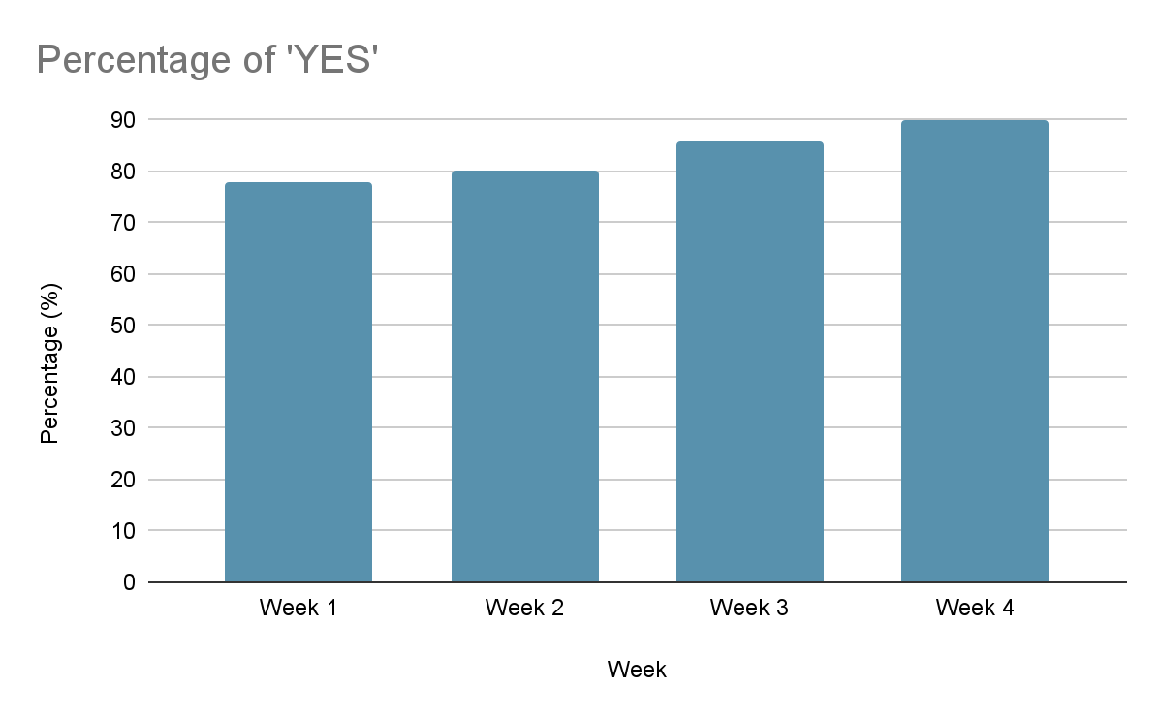
Did your shipment arrive on time?
[Insert chart or graph here]
Key takeaways & action items: After the first two weeks, the team hired more delivery drivers and reassessed delivery routes with the goal of bringing the on-time delivery rate from 80% to 95%

Slide 3
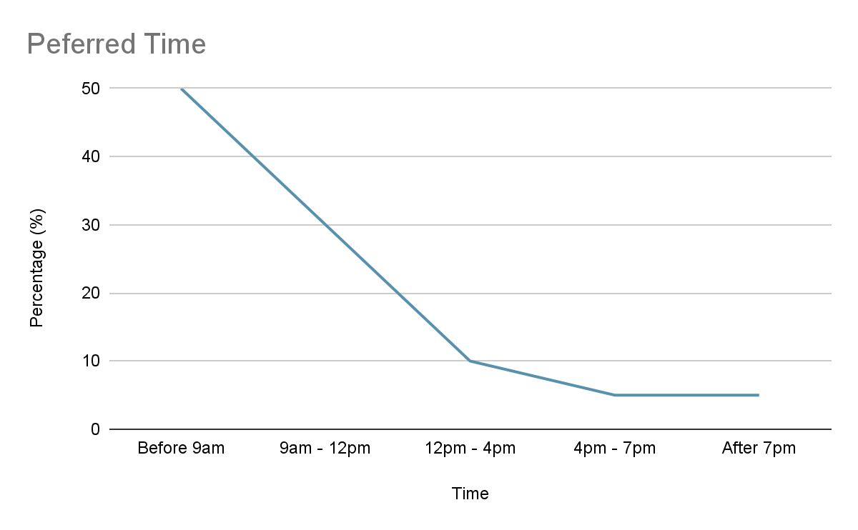
What is your preferred time of day to receive a shipment from Plant Pals?
[Insert chart or graph here]
Key takeaways & action items:The team will with delivering shipment between 7am and 4pm

Slide 4
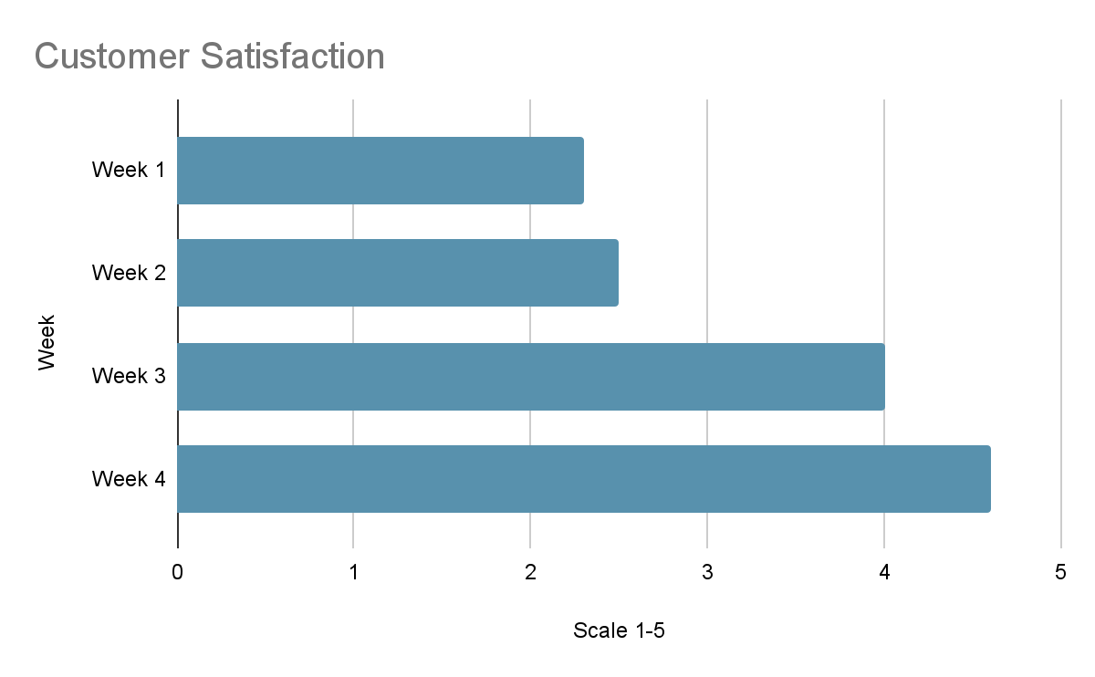
On a scale of 1 to 5, with 1 being the lowest and 5 being the highest, how satisfied are you with customer support?
[Insert chart or graph here]
Key takeaways & action items: The customers’ satisfaction increased as the team fixed a software issue that resulted in the customer relations team receiving only 30% of requests and complaints

Slide 5
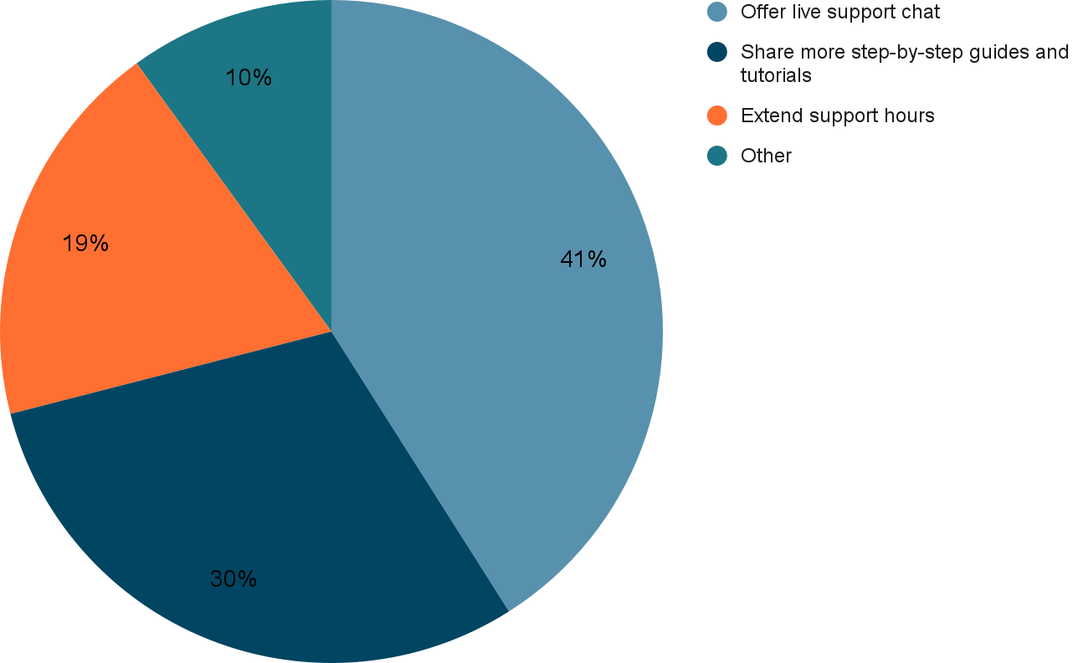
In general, how do you suggest we improve our customer support?
[Insert chart or graph here]
Key takeaways & action items: The team sent customers an e-newsletter with a tutorial on caring for their plants

Slide 6
Conclusion and next steps
The team did the following after the first two weeks of survey results:
Fixed a software issue that resulted in the customer relations team receiving only 30% of requests and complaints
Hired more delivery drivers and reassessed delivery routes with the goal of bringing the on-time delivery rate from 80% to 95%
Sent customers an e-newsletter with a tutorial on caring for their plants

